Slide 1
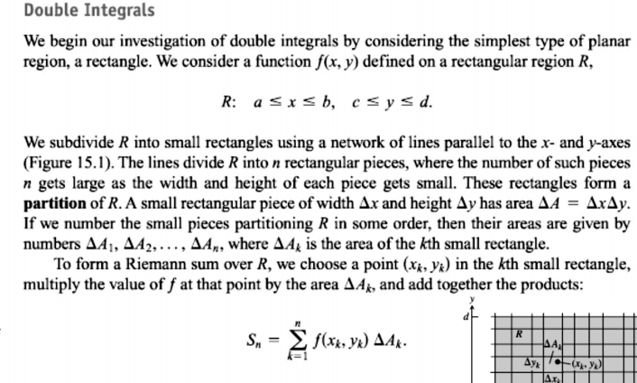
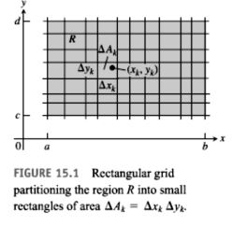
1 / Dep. Of Engineering Mechanics
MULTIPLE INTEGRALS
th
Class: 2 AMTHMATICS / Multiple Integrals

Slide 2
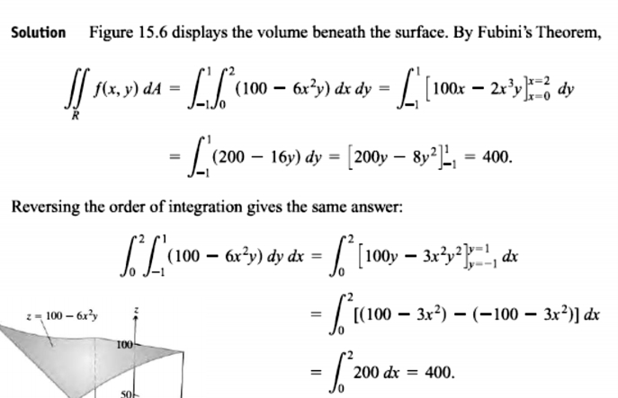
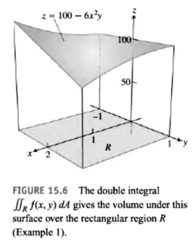
2 / Dep. Of Engineering Mechanics
th
Class: 2 AMTHMATICS / Multiple Integrals

Slide 3
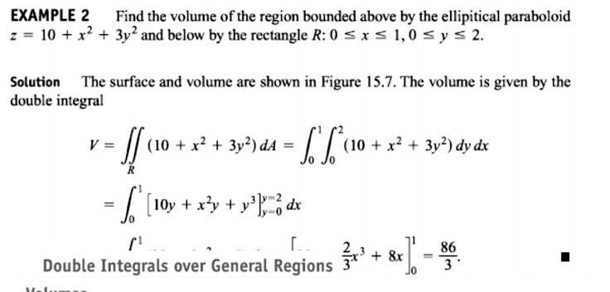
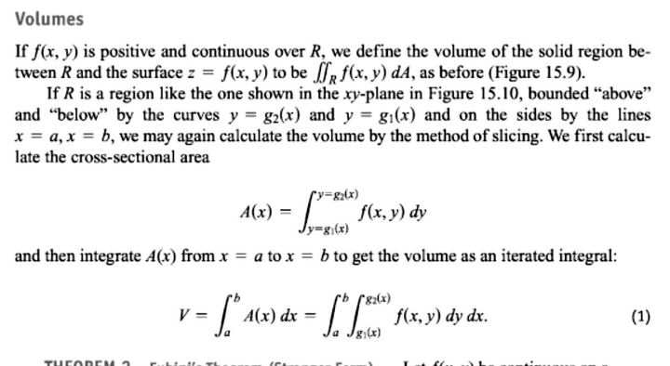
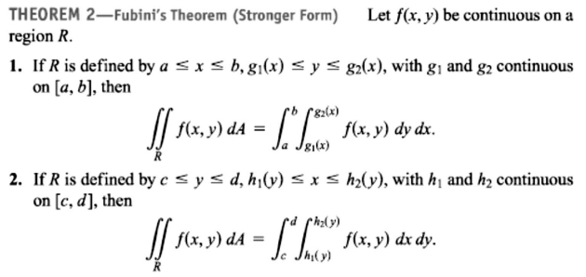
3 / Dep. Of Engineering Mechanics
th
Class: 2 AMTHMATICS / Multiple Integrals

Slide 4
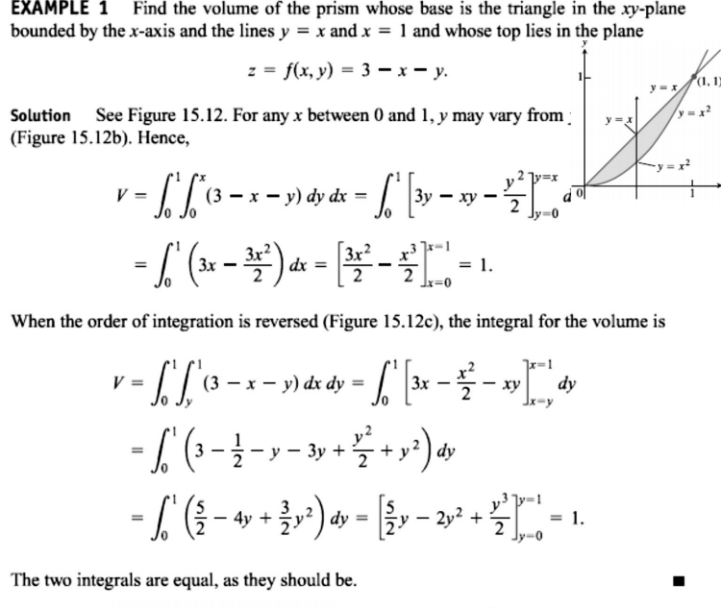
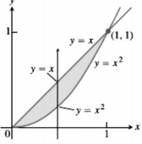
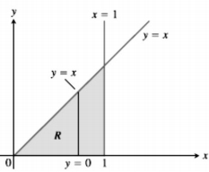
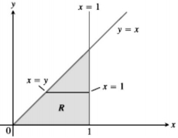
4 / Dep. Of Engineering Mechanics
th
Class: 2 AMTHMATICS / Multiple Integrals
b
c

Slide 5
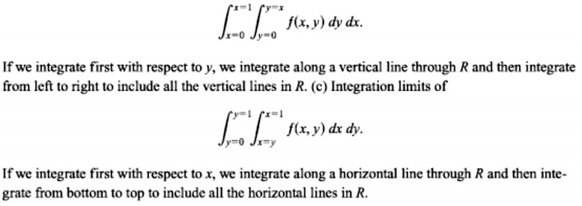
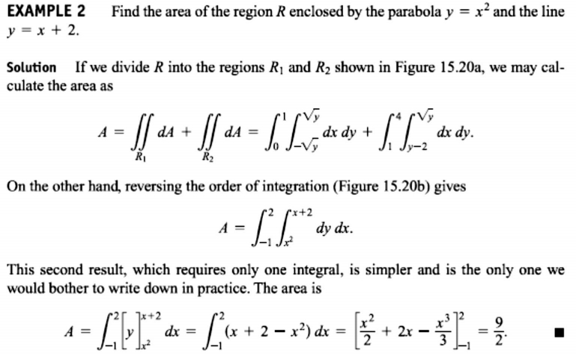
5 / Dep. Of Engineering Mechanics
th
Class: 2 AMTHMATICS / Multiple Integrals

Slide 6
